Slide 1
Frank Elavsky
Staff Data Visualization Engineer and Designer

Slide 2
Trinity Lutheran College
.
Computer Information Systems
& Philosophy
National Science Foundation
.
Undergrad Researcher in Visualization
Acumen LLC, Federal Research
.
Data Visualization Developer
Northwestern University, Research Computing
.
Data Visualization Specialist
Visa Inc
.
Staff Data Visualization Engineer and Designer

Slide 3
Data Visualization Team
Designers
Engineers
Product
Data Science
Business Intelligence
Data Systems

Slide 4
Design Systems
Designers
Engineers
Angular
Data Viz
React

Slide 5
What are design systems?

Slide 6
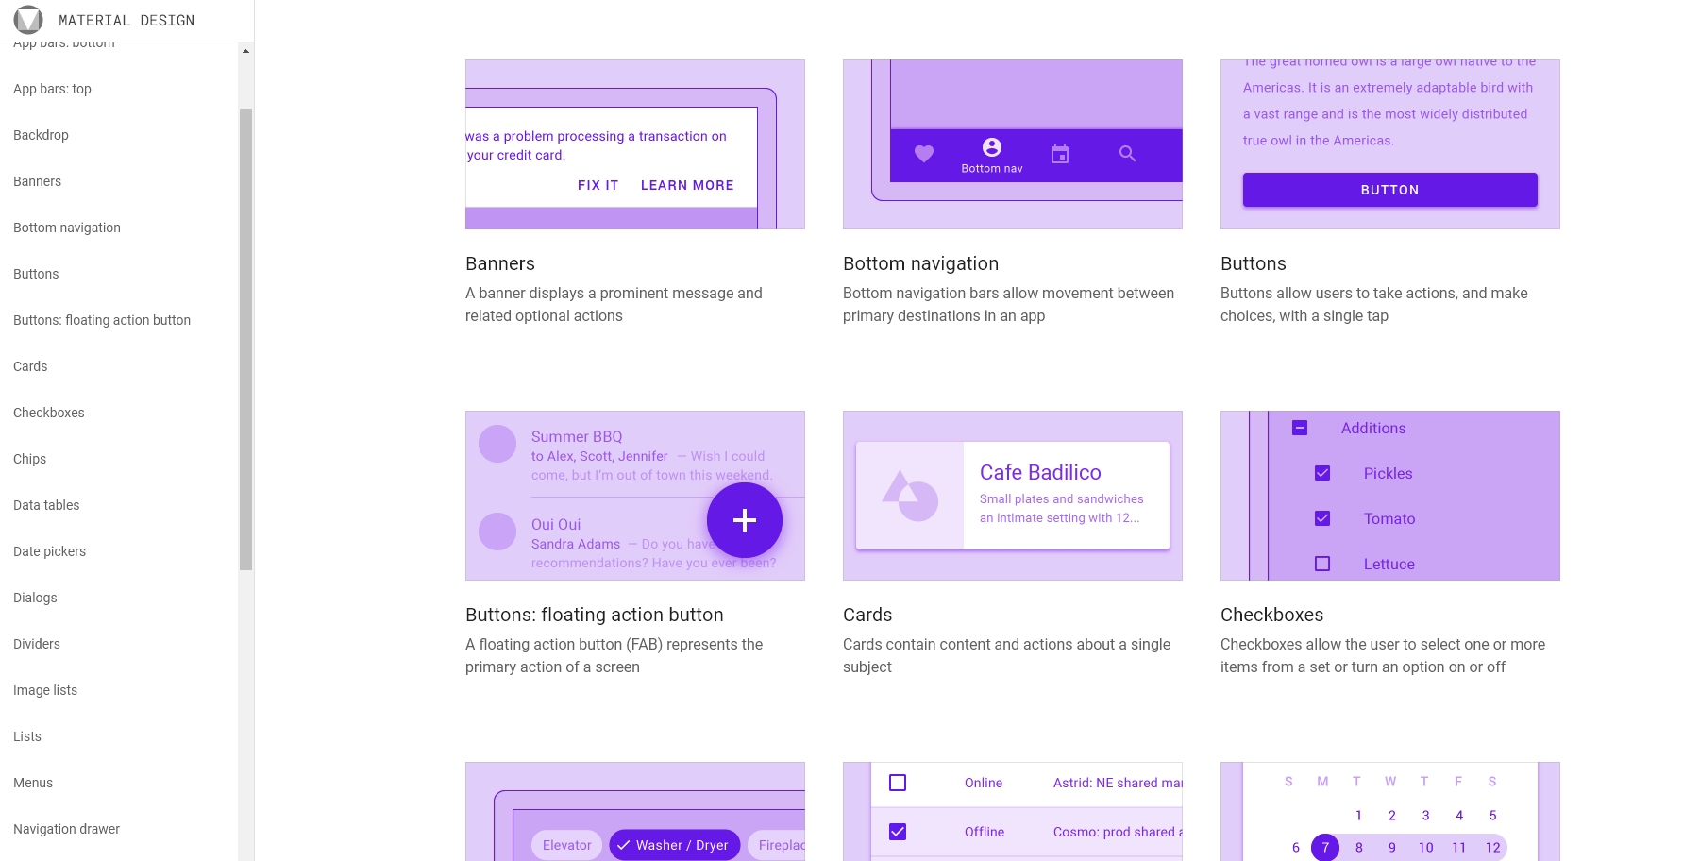

Slide 7
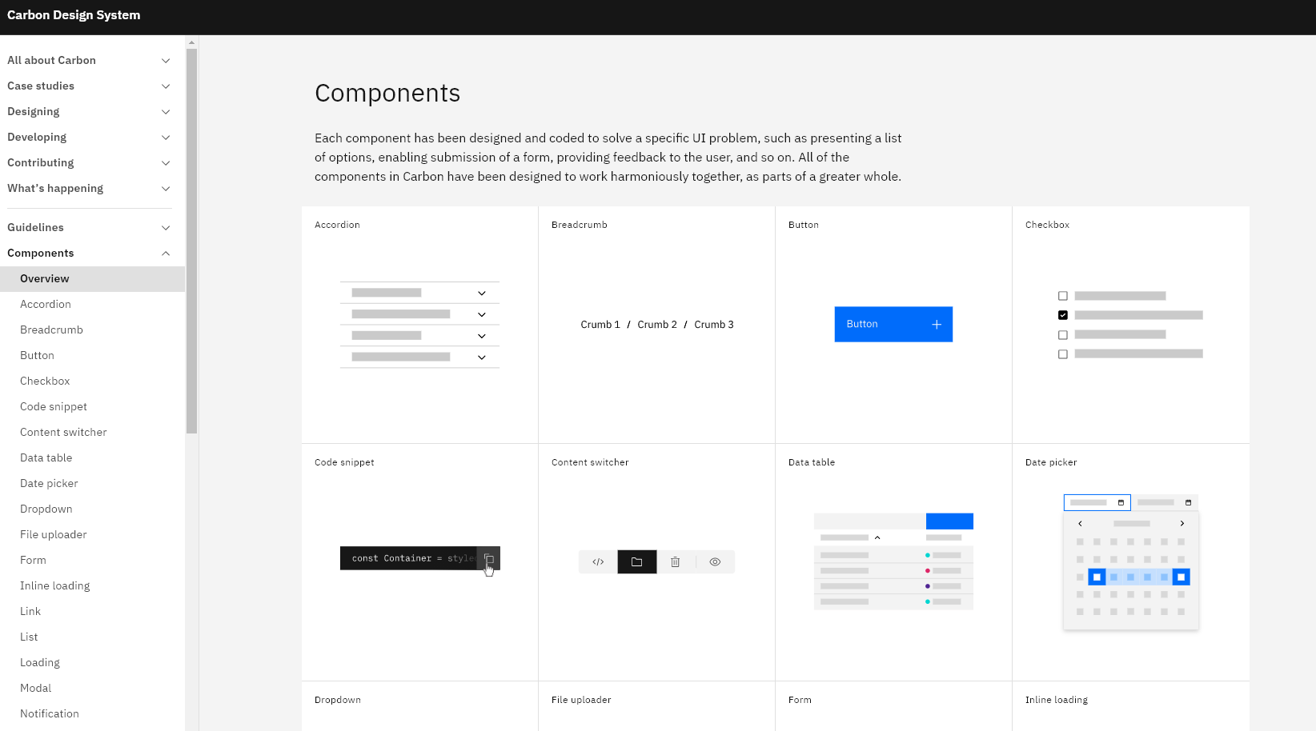

Slide 8
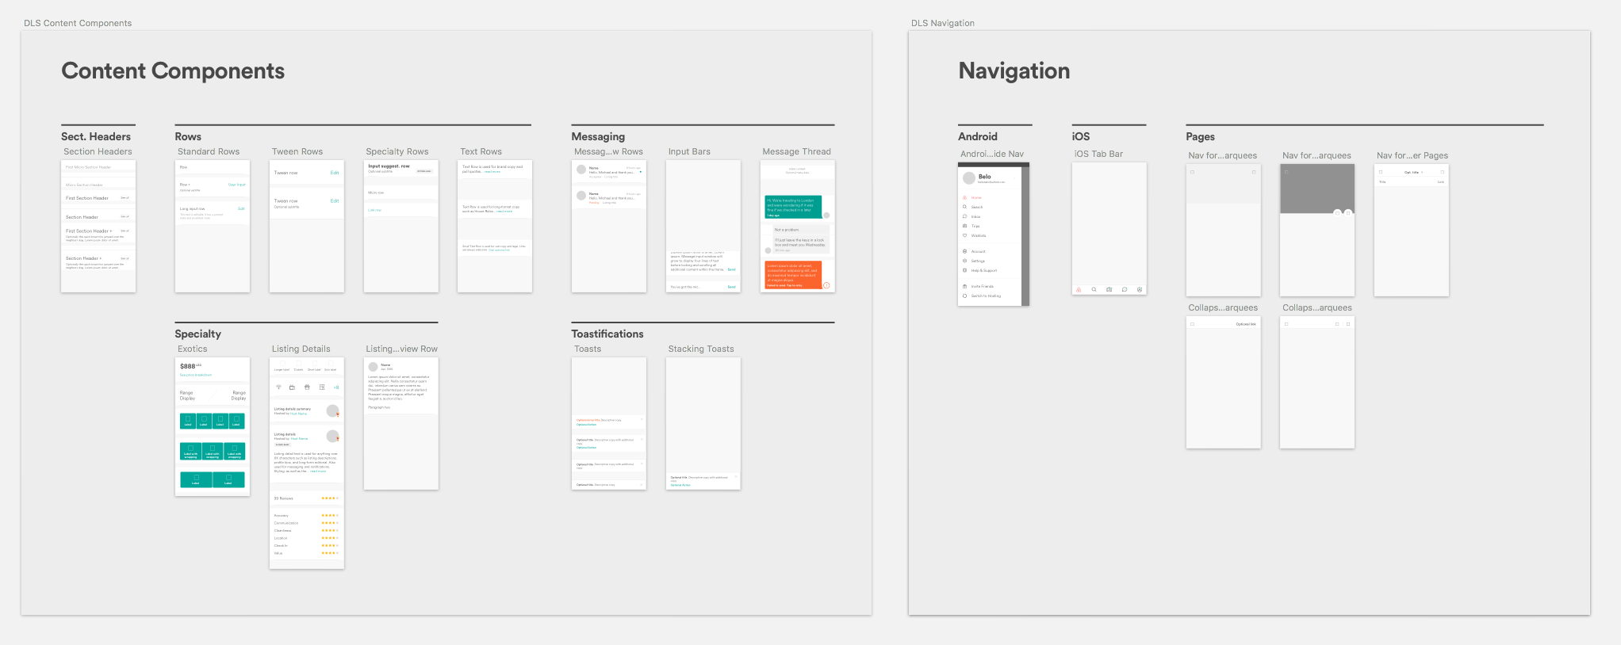

Slide 9
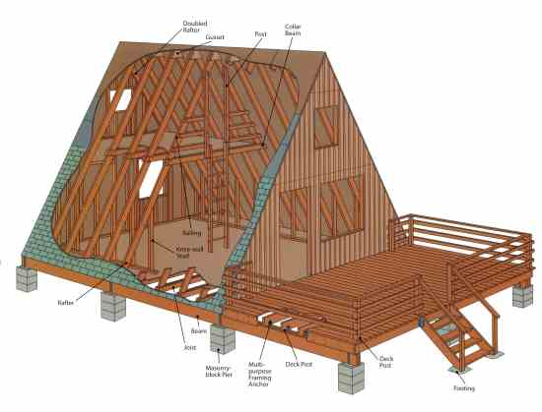
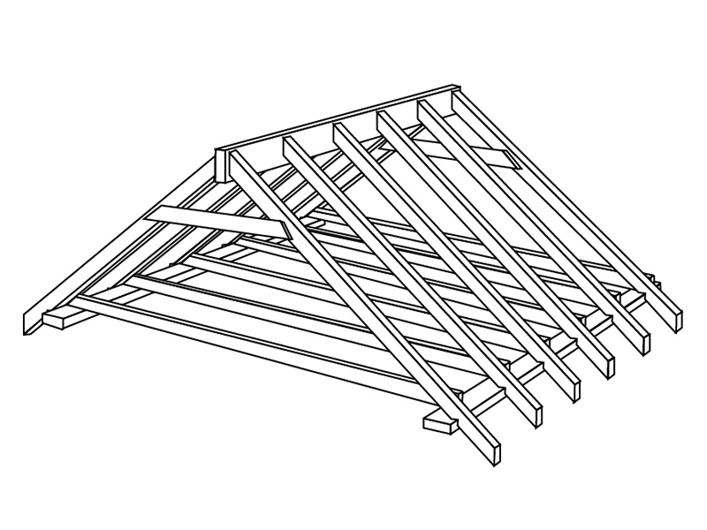

Slide 10
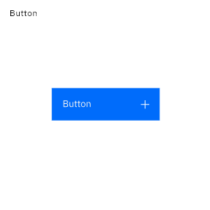
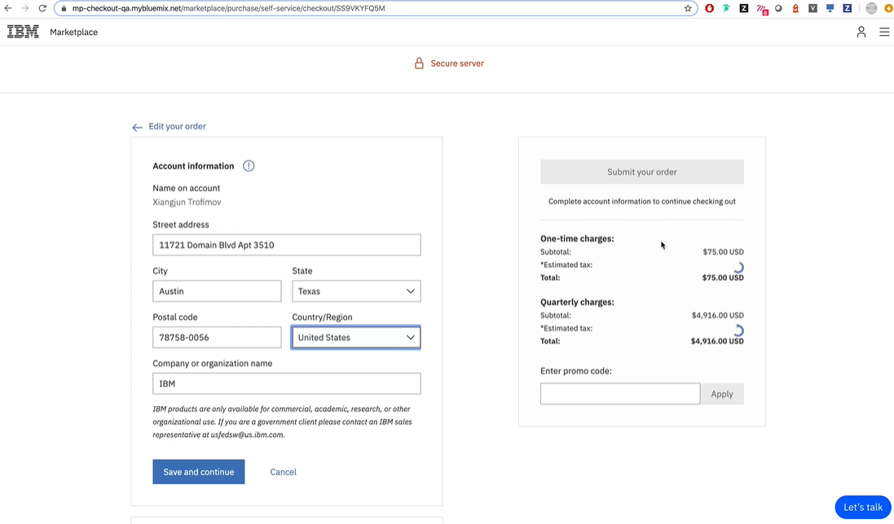
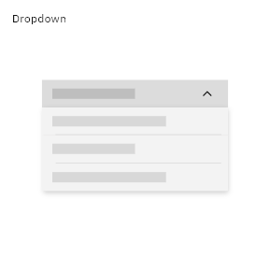
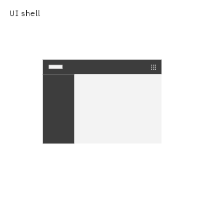

Slide 11
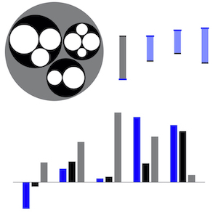
Visa Chart Components

Slide 12
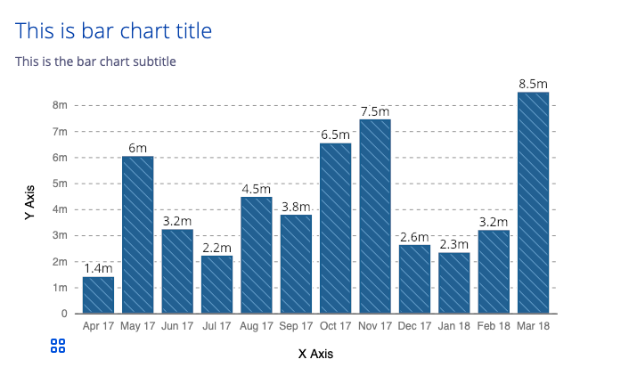
A Bar Chart Design System Component

Slide 13
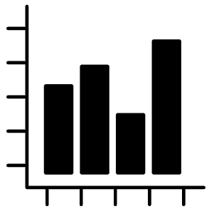
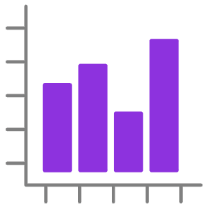
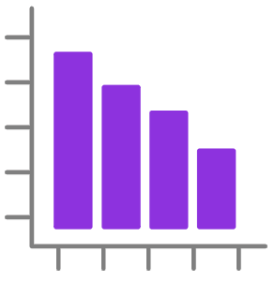
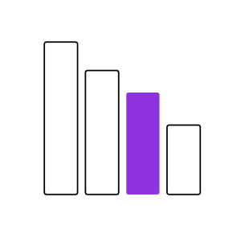
Design once, Develop once,
Use everywhere

Slide 14
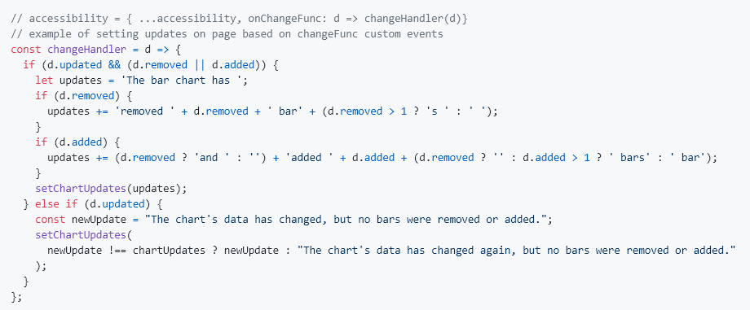
Our “Audience”? Developers.

Slide 15
Their Audience? Global users

Slide 16
Accessibility

Slide 17
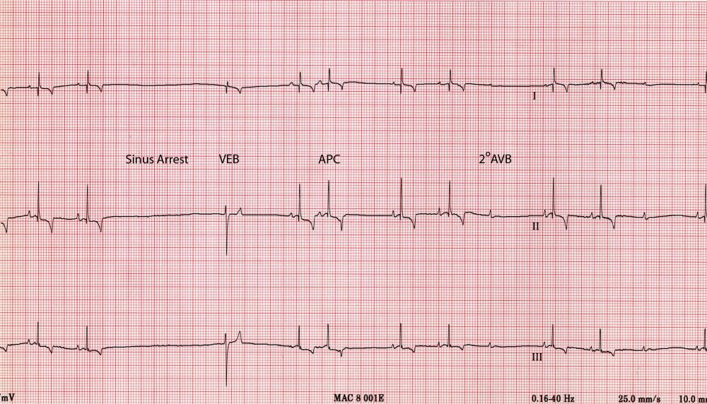
Data is critical, but in new ways

Slide 18
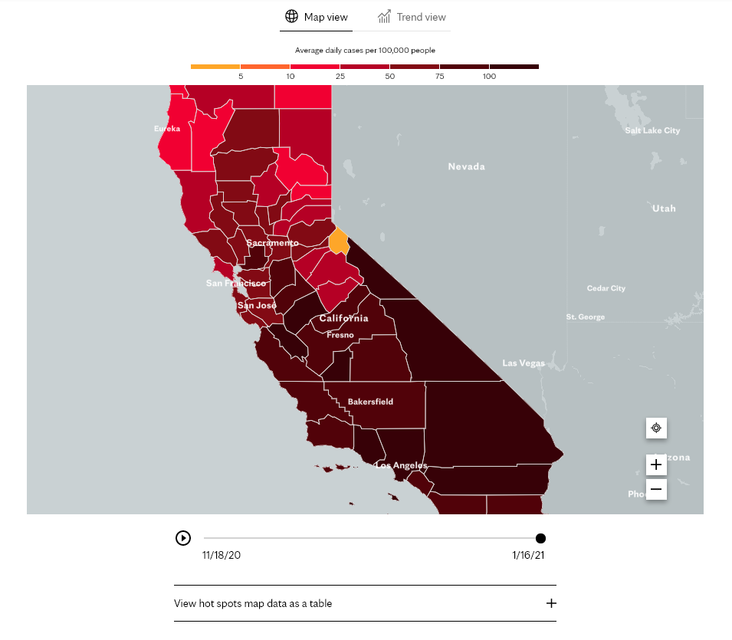
Covid Outbreak Data Tracking

Slide 19
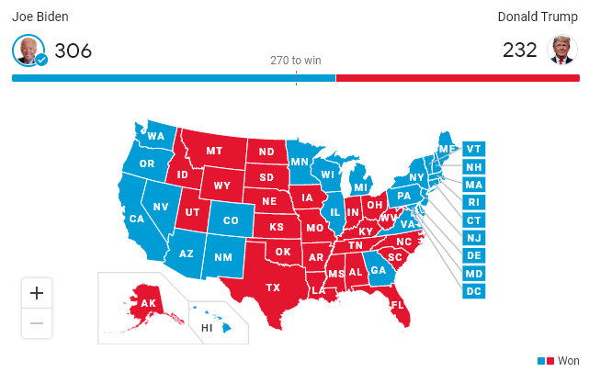
2020 Presidential Election Visualizations

Slide 20
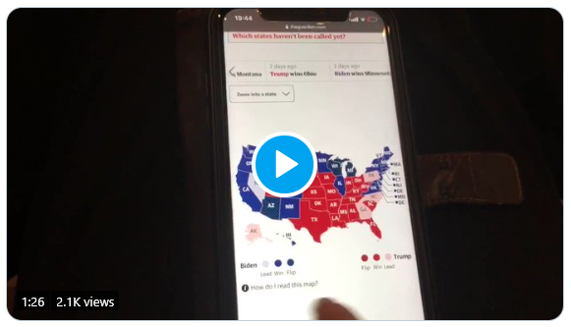
What a screen reader user experiences
Visualization Accessibility Audit by Sarah Fossheim

Slide 21
Accessibility (A11y)
Accessibility is about providing access.
It is making something usable by as many people as possible, regardless of their disability.

Slide 22
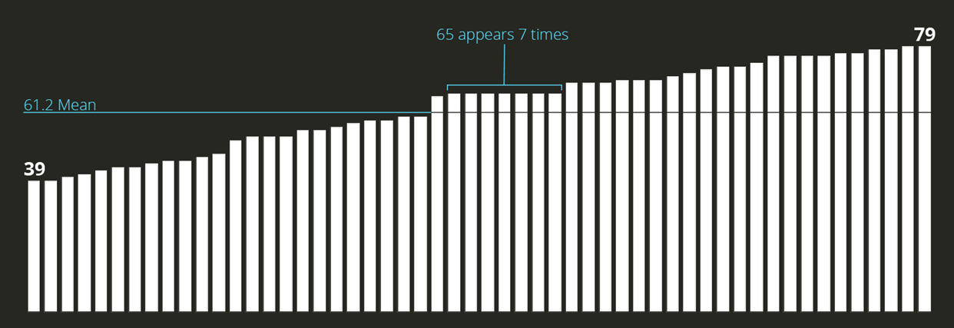
An example chart.

Slide 23
Simulated diabetic retinopathy and glaucoma.

Slide 24
Colorblindness: ~4.5% of those with Eur. Ancestry
Low vision: ~25% of all people
Vision correction (broadly): ~75% of all people

Slide 25
Severe Disability: ~8.5% of all people
Functional Impairment: ~17.5% of all people
Temporary disability: 100% of us at some point

Slide 26
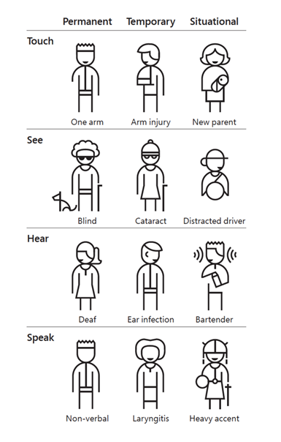
Types of Disability
Some disabilities are permanent.
Others are temporary.
And some are situational.

Slide 27
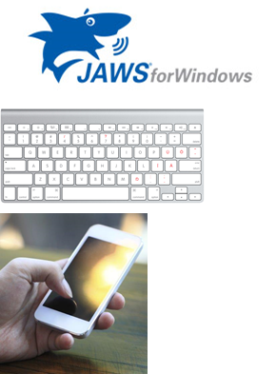
Top 3 Accessibility Tips:
Some people use Screen Readers to access information. Add alt text.
Other folks use a keyboard instead of a mouse. Ensure keyboard access.
And sometimes just the brightness in a sunny location can make a mobile device hard to see. Design with high contrast.

Slide 28
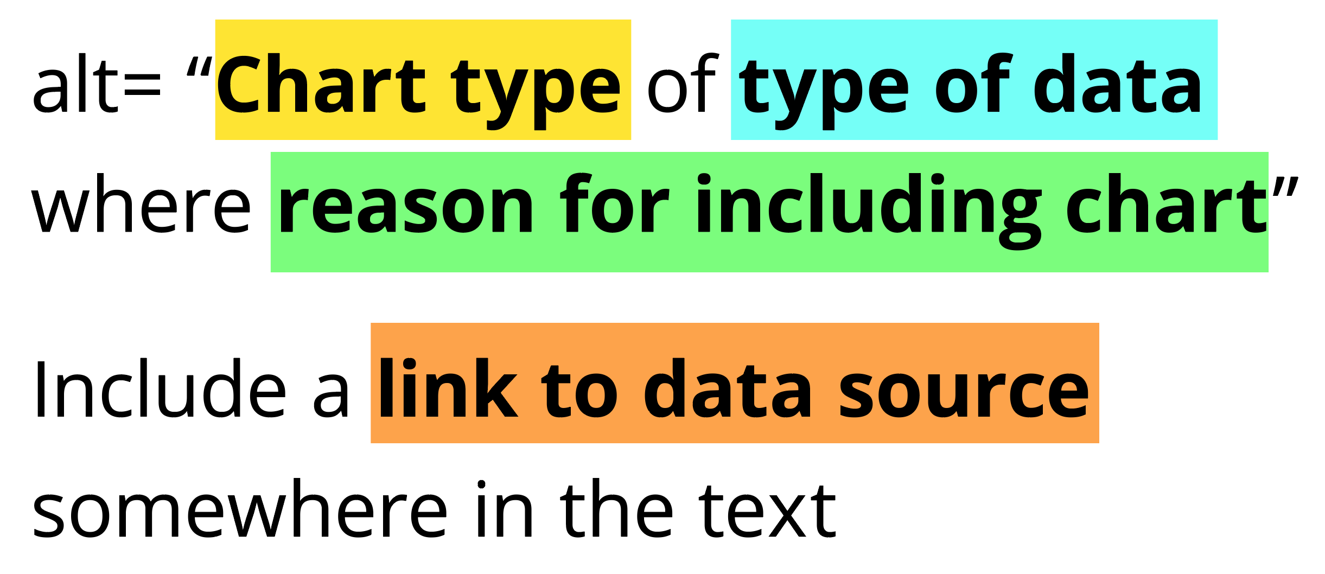

Slide 30
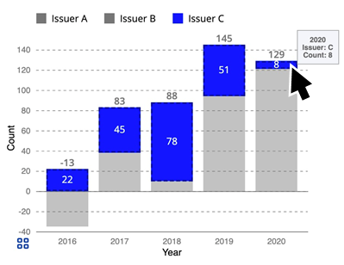
Ensure Keyboard Access (if interactive)

Slide 31
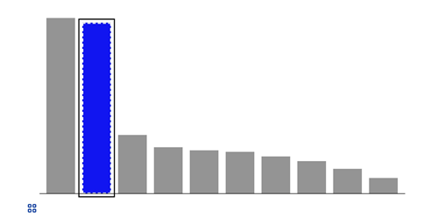
Indicate keyboard focus, use multi-modal style
This is a keyboard focus indicator (outer border) with the same styling effect applied on mouse hover (inner dashed white lines and blue fill)

Slide 32
Design with high contrast
Colorblindness Disproportionately Overrepresented in A11y Resources
Colorblindness Disproportionately Overrepresented in A11y Resources
Colorblindness: % of People
Colorblindness: % of People
4%
4%
Low Vision: % of People
Low Vision: % of People
25%
25%
Colorblindness: # of Resources
Colorblindness: # of Resources
51
51
Low Vision: # of Resources
Low Vision: # of Resources
5
5

Slide 33
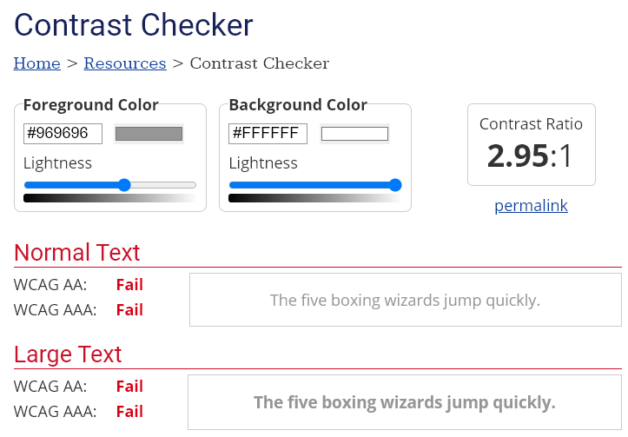
Use High Contrast Text
Text needs at least 4.5:1 contrast against its background.
Large text (bold and 16pt or larger) can be 3:1 or higher.

Slide 34
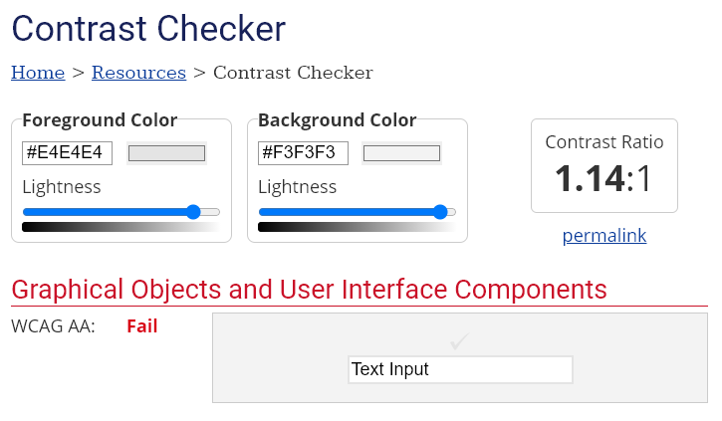
Use High Contrast Geometries
Chart elements need at least 3:1 contrast against their background.

Slide 35
Other resources for learning more about A11Y
A11y Project and A11y Project Checklist
Deque accessibility training
Inclusive Design Principles
Microsoft’s Inclusive Design Guide
Practical Handbook on Accessible Graphic Design
Solid Start
Web Accessibility Initiative’s Introduction to Web Accessibility
Web Content Accessibility Guidelines (WCAG)

Slide 36
Resources for learning more about A11Y + Viz
Accessibility Considerations in Data Visualization Design, by keenblog
An Introduction to Accessible Data Visualizations with D3.js, by Sarah Fossheim
An Intro to Designing Accessible Data Visualizations, by Sarah Fossheim
How (not) to Make Accessible Data Visualizations, by Sarah Fossheim
The Importance of Accessibility in Data Visualizations, by Hayley Ponta
Why Accessibility is at the Heart of Data Visualization, by Doug Schepers
Writing Alt Text for Data Visualization, by Amy Cesal

