Slide 1
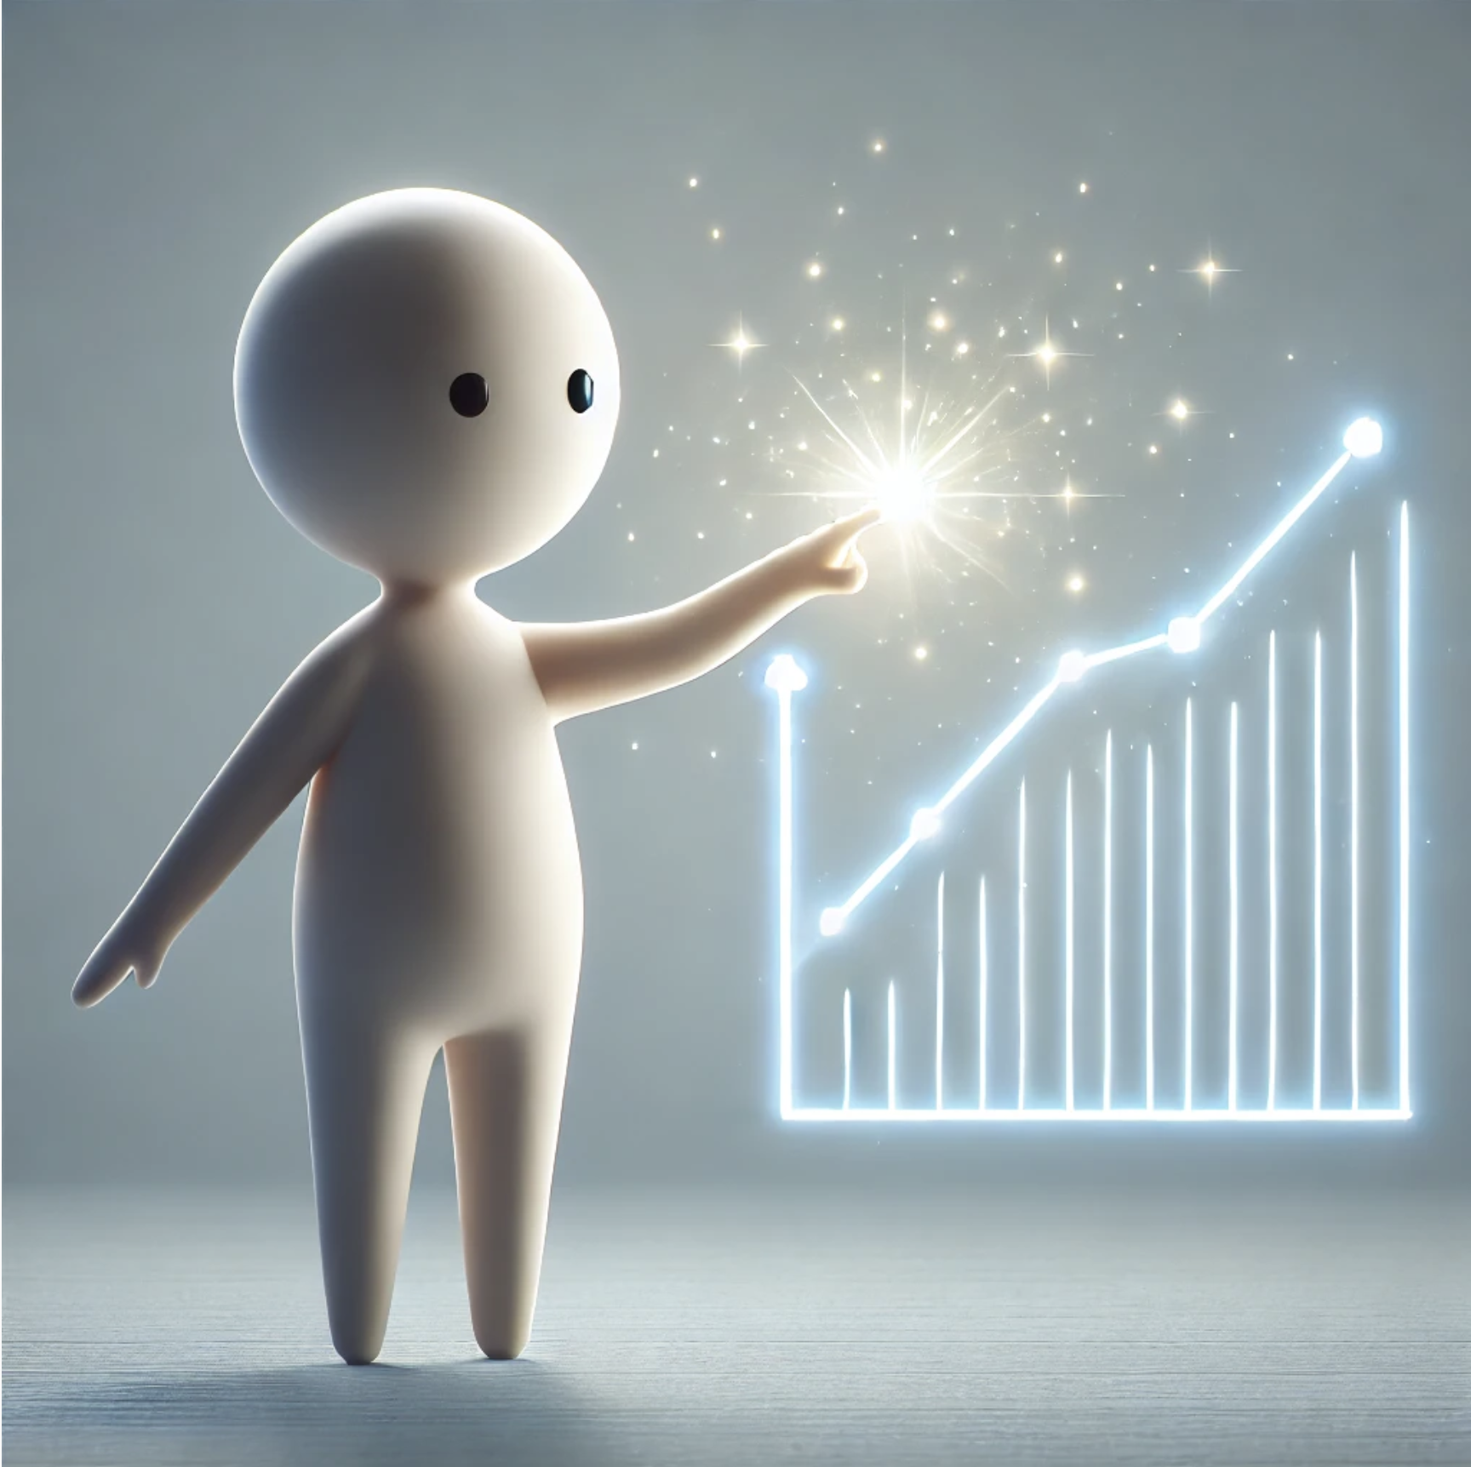
Personalization of Accessible Charts and Graphs
Marita Vindedal
Ted Gies
Frank Elavsky
Øystein Moseng
Customized icon/illustration
or, an image of Chart / Photo
CSUN 2025
12 March 2025 2:20 PT
Grand GH

Slide 3
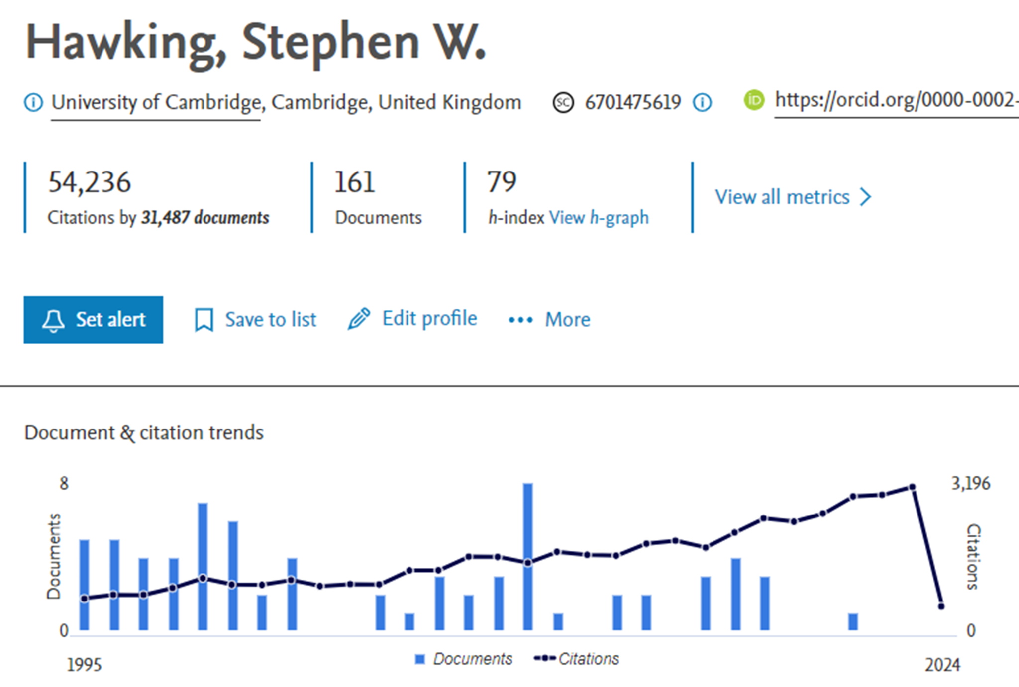
Elsevier Relies on Highcharts to Depict Researcher Performance

Slide 4
Elsevier + Highcharts (Collaborating Since 2015!)
“Hi Øystein, we are currently using Highcharts as our data visualization engine for our Scopus product. Would you like to work on making the functionality work better for accessibility (like keyboard users?)”

Slide 5
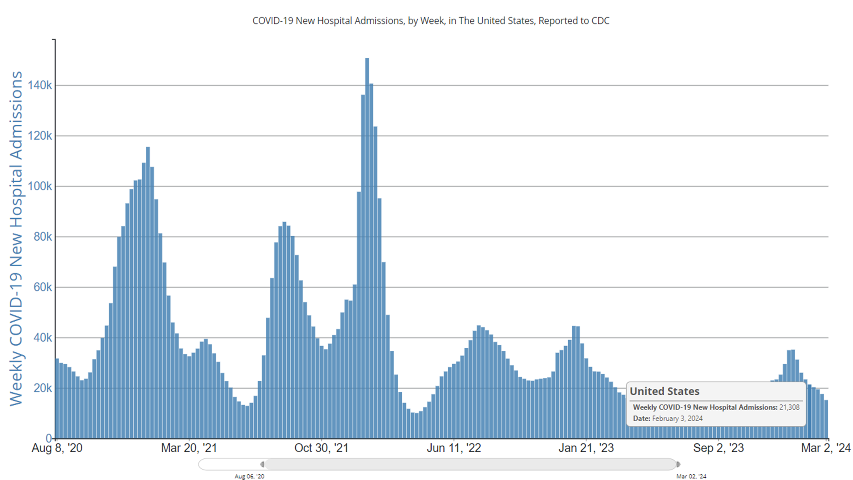
Science and Health Depicts Serious Data in Charts and Graphs Bar Chart Depicting Weekly COVID-19 Cases Aug 2020 through Mar 2024

Slide 6
“There are probably ways to look for the trend, but I never look because I expect it to be inaccessible.”
Stanford COVID-19 2021 Viz study (A. Siu, et al) – Feedback from Person who is Visually impaired
Notes:
So graphs are largely inaccessible, but what about the trends, are they accessible?
Here’s a representative quote from Stanford paper about the low expectations around spotting trends like spikes in COVID cases and hotspots in geo maps.
“there are probably ways to look for the trend but I never look because I expect it to be inaccessible” (P8).
COVID-19 Highlights the Issues Facing Blind and Visually Impaired People in Accessing Data on the Web (Stanford HCI Group, 2021)

Slide 7
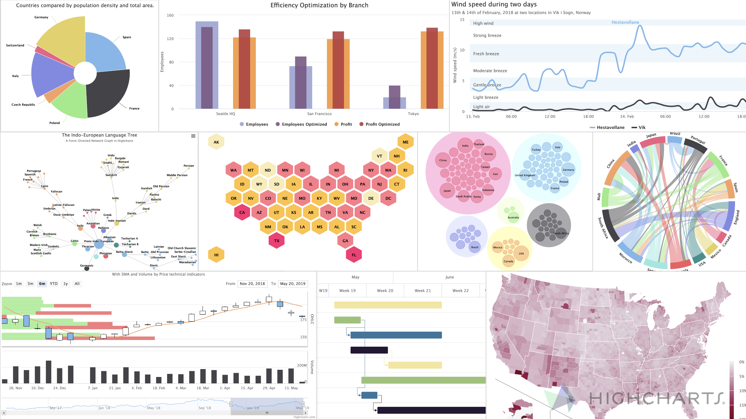

Slide 8
Our Current Research Focus in Accessible Data Vis
Next Talk: Interactive Charts for Everyone Thursday 9:20 AM Grand CD
Provide Non-visual Access
Data Points
Data Structure
Screen Reader Compatibility
Trends
Tactile
Auditory
Flexibility/Freedom of Exploration
Keyboard Quick Keys
Application Role
Table Vs. Marked Up SVG
Intuitive Orientation Cues
Reduce Information Overload
Verbosity
Large Datasets
Sparklines
Curve Smoothing
AI Summaries
Increase Interactivity and Engagement
Provide multi-sensory experience of data
Efficient Keyboard Model
Ability to discover trends
Device independent interatction
Increase User Efficiency
Flexible ways to find data
Improve orientation
Improve Usability overall
Simple KB commands

Slide 9
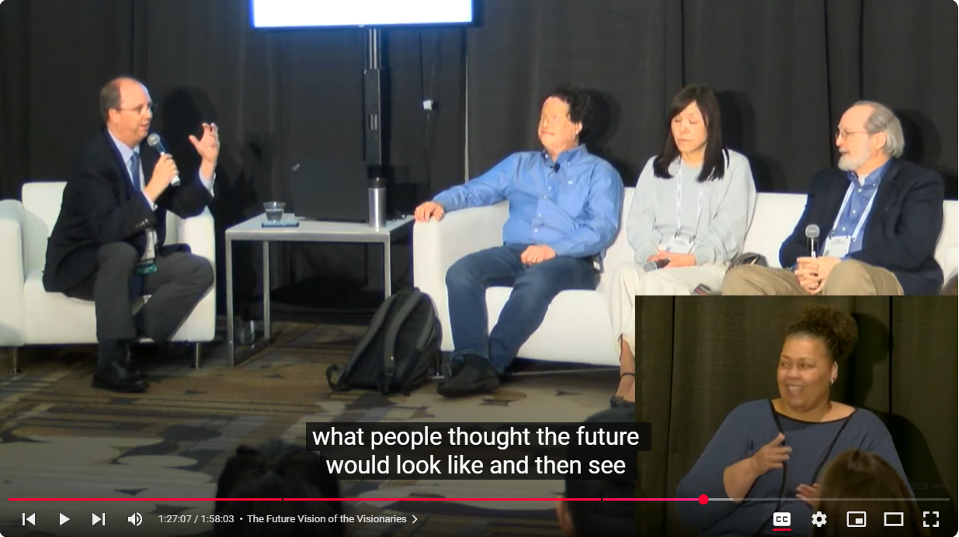
Personalization – The Future of Accessible User Interfaces?
The Future of the Visionaries (CSUN 2023) The interface adapts to us rather than Assistive Technology or User Having to Adapt to the interface.
Panelists
Mike Paciello
Dr. Josh Miele
Dr. Gregg Vanderheiden
Dr. Chieko Asakawa

Slide 10
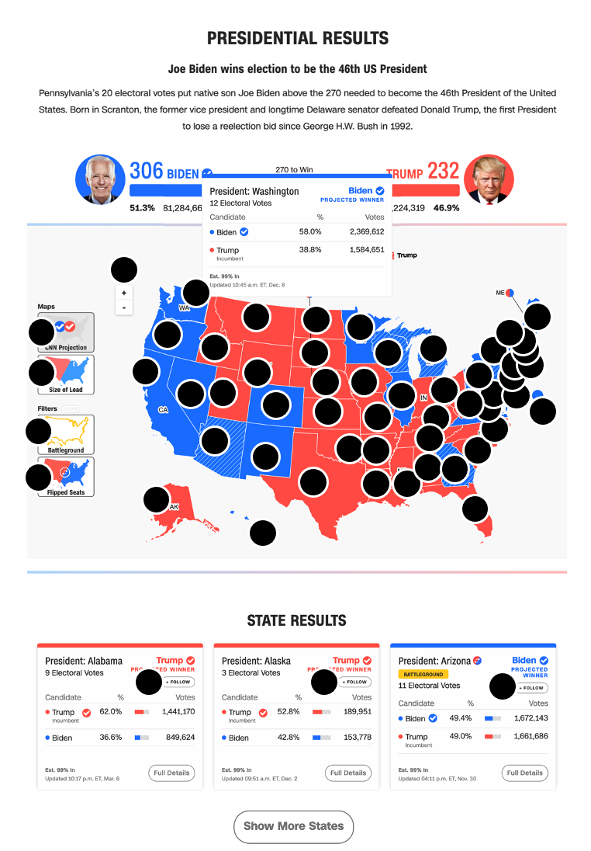
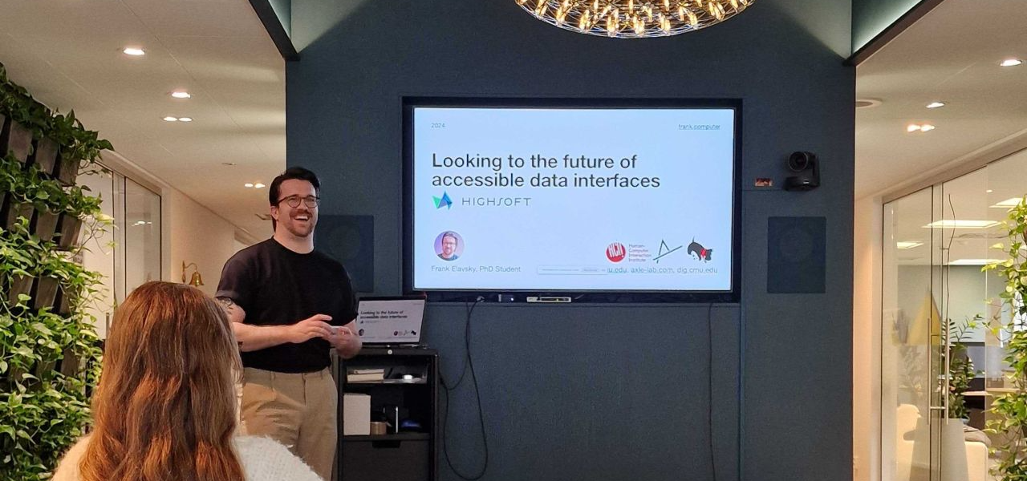
Teaching accessibility and visualization
Notes:
Hci researcher, teach, chartability, but I get q/a - common problem arises

Slide 11
What about this visualization might be a barrier?
Notes:
Let's say someone builds a pretty darn accessible chart – like this one shown here. Shown here is a sankey diagram. This chart visualizes flows and the flows look like pipes, or noodles, of different thicknesses. Noodles in the sankey that are thick like lasangna noodles have big numbers and the thin ones, like angel hair pasta, have small values. According to standard testing, this is really accessible.

Slide 12
What about this visualization might be a barrier?
Font size too small

Slide 13
What about this visualization might be a barrier?
Font size too small
Black text on light background is hard

Slide 14
What about this visualization might be a barrier?
Font size too small
Black text on light background is hard
Textures + colors are overwhelming

Slide 15
What about this visualization might be a barrier?
Font size too small
Black text on light background is hard
Textures + colors are overwhelming
Explanation doesn't have a summary, it isn't enough

Slide 16
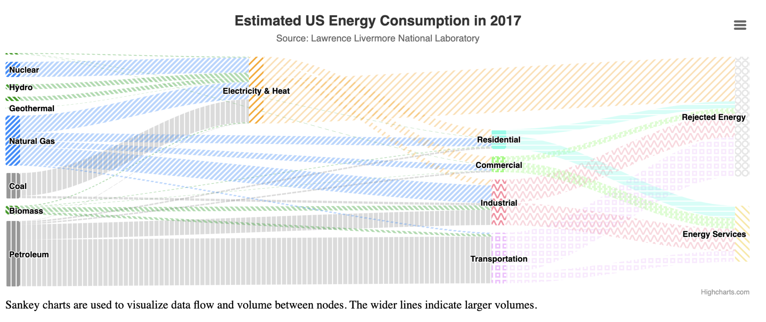
Can we fix this?

Slide 17
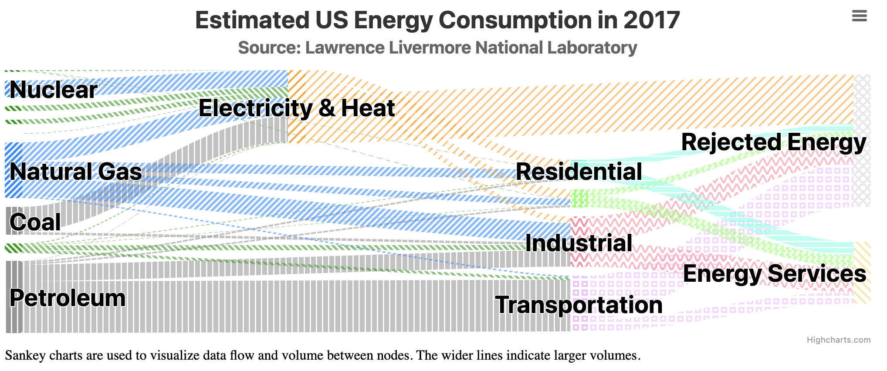
Maybe we can bump up the text size

Slide 18
We can reduce visual complexity too

Slide 19
We can add a more descriptive explanation

Slide 20
Is this the perfect, most accessible design?

Slide 21
Bad news...

Slide 22
Bad news...
This design has accessibility issues too

Slide 23
There is no such thing as a single, perfect visualization

Slide 24
One design cannot fit all

Slide 25
Why should our chart designs be one-size-fits-all?

Slide 26
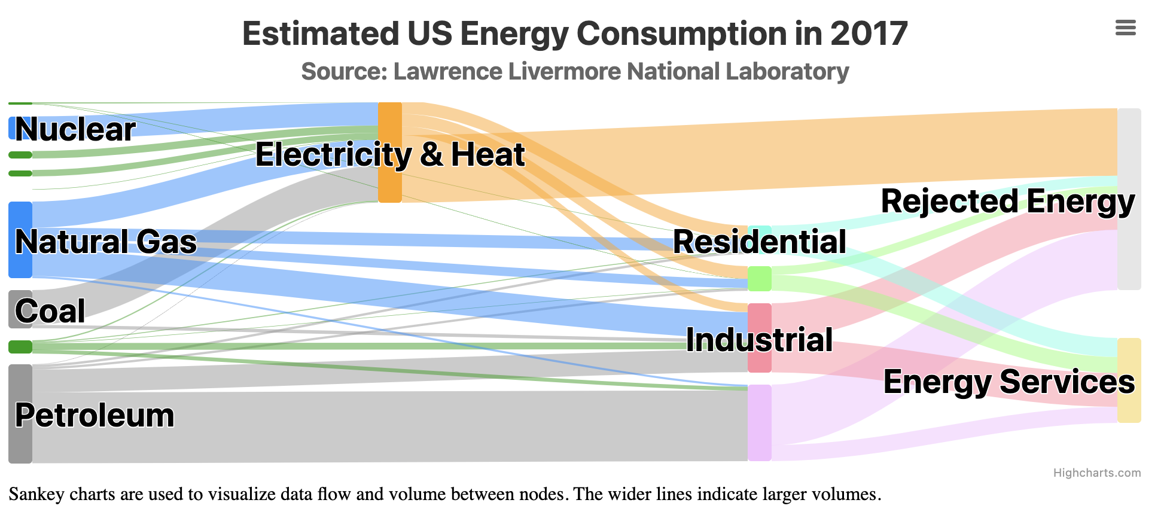
Good design enables personalization

Slide 27
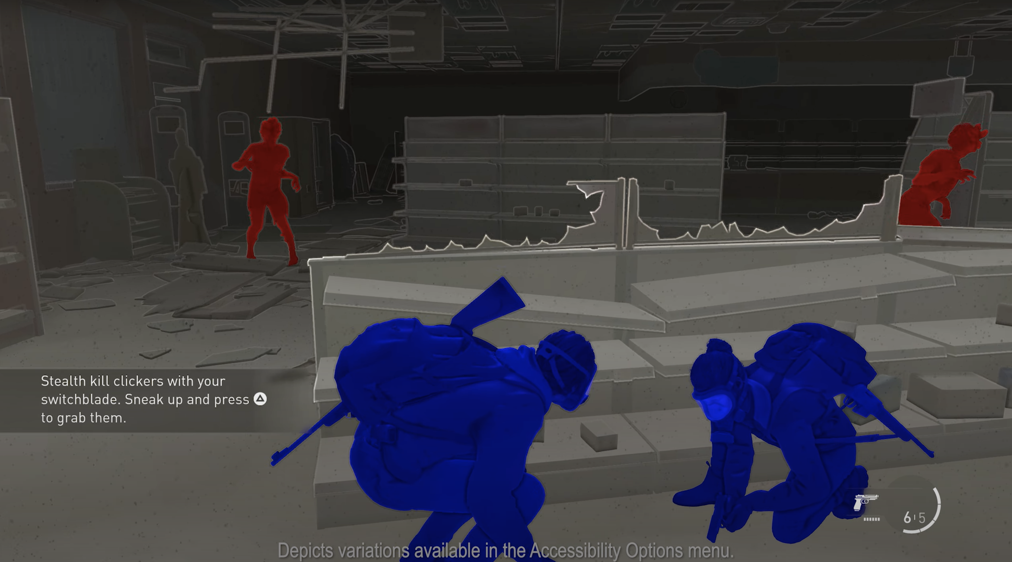
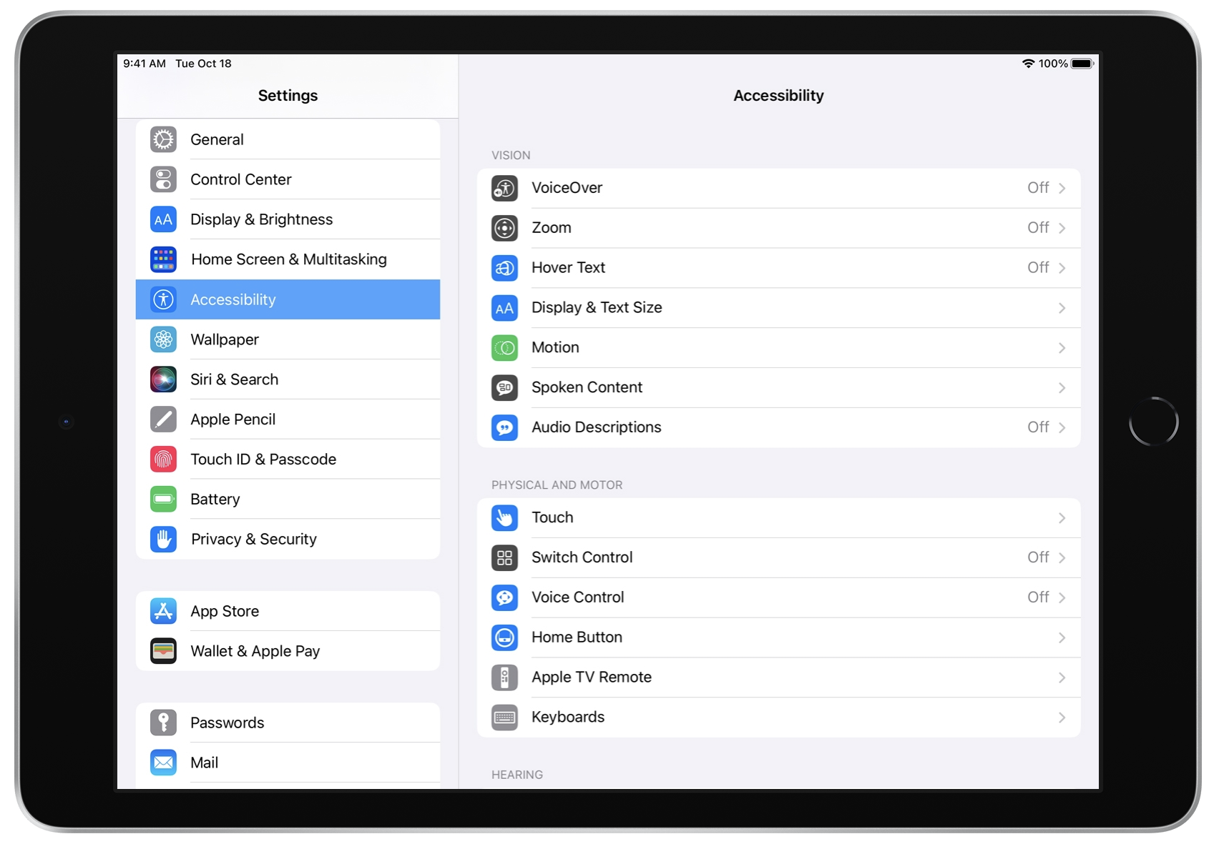
We have been enabling personalization for years
Video games
Devices and operating systems
The Last of Us 2 has more than 60 settings
"Make it yours" is the motto for Apple's accessibility personalization

Slide 28
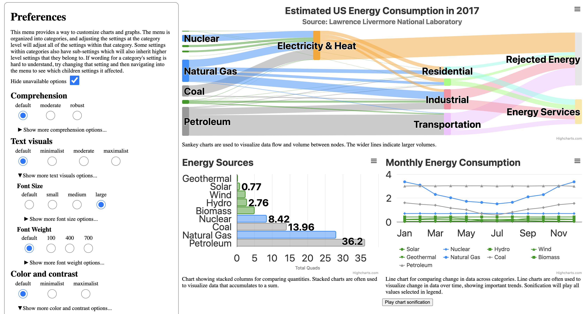
We built a preferences menu!

Slide 29
We took a pass at customization options: 195 categories and 774 choices

Slide 30
We took a pass at customization options: 195 categories and 774 choices

Slide 31
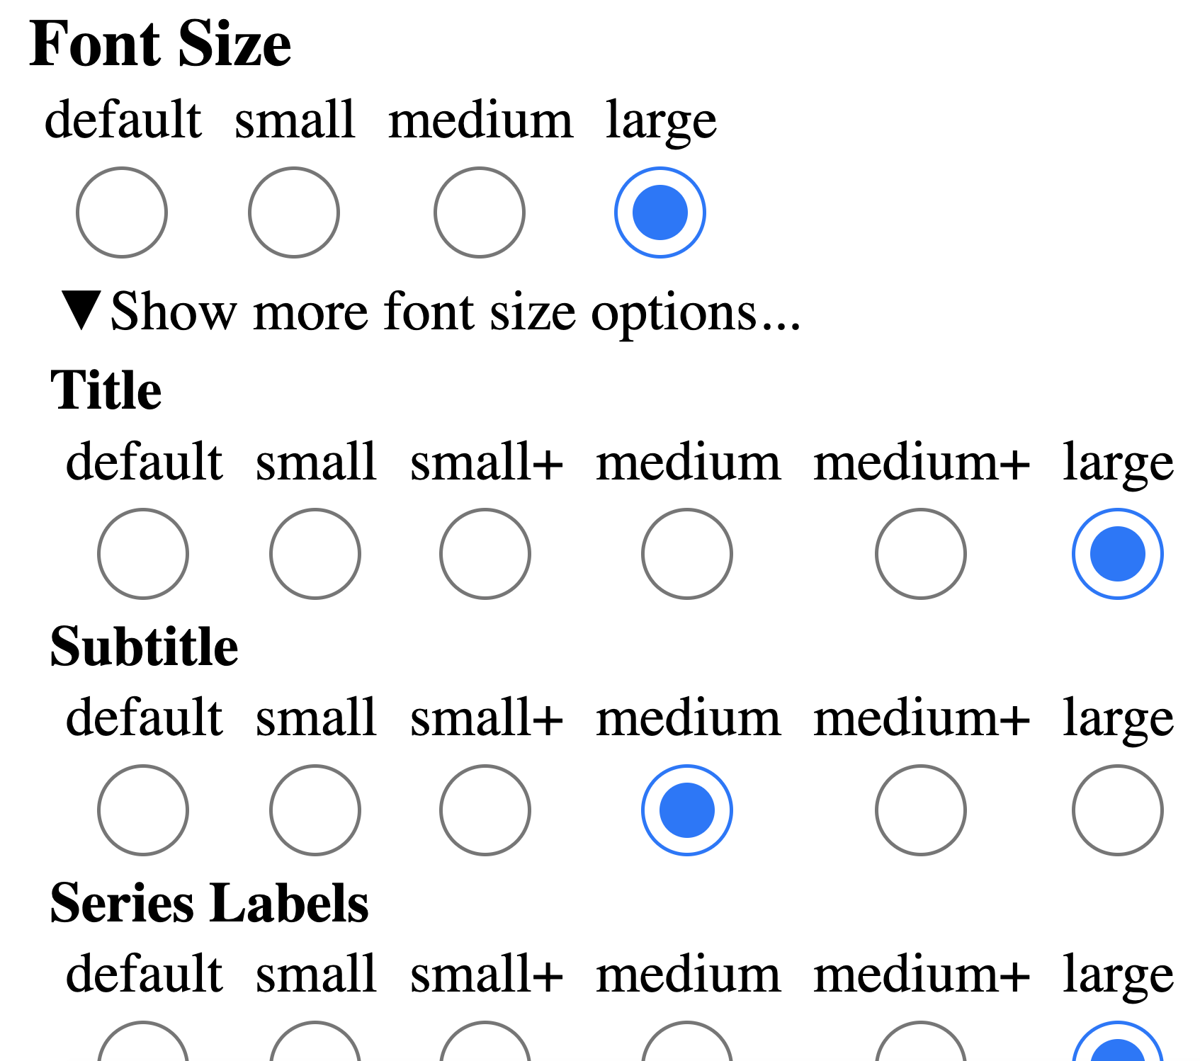
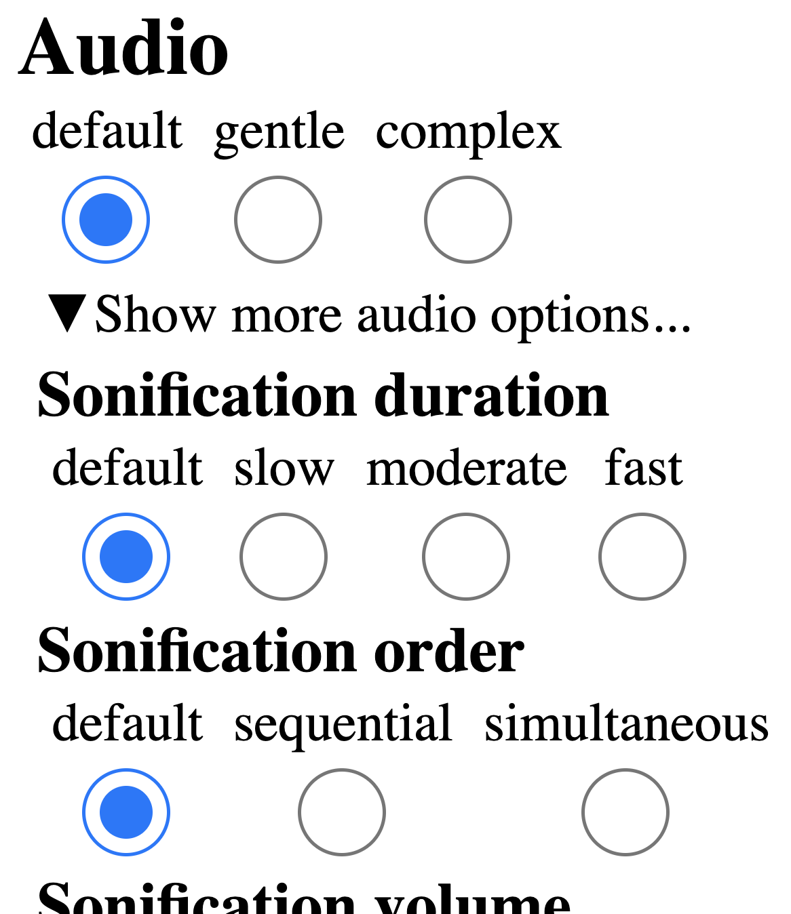
We took a pass at customization options: 195 categories and 774 choices

Slide 32
There are far more unique ways to personalize one visualization than there are atoms in our universe
(1.0e80 vs 6.83e114)
Image credit: NASA

Slide 33
We don't want users to build their own access from scratch!

Slide 34
Don't give users garbage and expect them to clean it up

Slide 35
"Users: Fix our garbage" (modern overlay strategies)

Slide 36
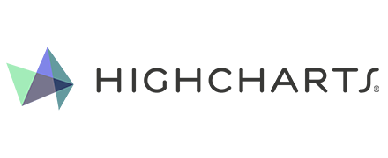
Collaborating with the best: Fundamental + Product research

Slide 37
Why did we choose a "Preferences" menu?

Slide 38
Why did we choose a "Preferences" menu?
Familiar design (easier to test our questions)
"Accessibility settings" (has worse adoption/use)
Inspectable (state & available interactions are perceivable)
Foundational prototype (leads to future UX ideas)

Slide 39
Why did we choose a "Preferences" menu?
Familiar design (easier to test our questions)
"Accessibility settings" (has worse adoption/use)
Inspectable (state & available interactions are perceivable)
Foundational prototype (leads to future UX ideas)
Auto-adapting, smart systems need goals

Slide 40
Why did we choose a "Preferences" menu?
Familiar design (easier to test our questions)
"Accessibility settings" (has worse adoption/use)
Inspectable (state & available interactions are perceivable)
Foundational prototype (leads to future UX ideas)
Auto-adapting, smart systems need goals
Direct-manipulation interfaces need to store system state

Slide 41
Why did we choose a "Preferences" menu?
Familiar design (easier to test our questions)
"Accessibility settings" (has worse adoption/use)
Inspectable (state & available interactions are perceivable)
Foundational prototype (leads to future UX ideas)
Auto-adapting, smart systems need goals
Direct-manipulation interfaces need to store system state
Chat and voice-based interaction needs target language

Slide 42
What do people with disabilities want to personalize in their charts?

Slide 43
We gave 9 BLV users and 4 developers some levers to pull

Slide 44
(What is accessible for one...)
“If anything has dark mode? That’s great. I wish everything used dark mode.”
Participant #4

Slide 45
(...might be a barrier for another.)
“Oh, I can’t use dark mode at all. I hate when websites have [dark mode] because it can be virtually impossible to use.”
Participant #7

Slide 46
Fundamental research: Guiding principles
Malleable interfaces need guardrails
It is possible to design harmful visualizations, so system designers should anticipate ways to help users personalize safely.

Slide 47
Fundamental research: Guiding principles
Malleable interfaces need guardrails
It is possible to design harmful visualizations, so system designers should anticipate ways to help users personalize safely.
Our ethical responsibility: Accessible defaults first
Some users won't want to personalize or manipulate interfaces at all, so they will still rely on smart, effective defaults.

Slide 48
Fundamental research: Guiding principles
Malleable interfaces need guardrails
It is possible to design harmful visualizations, so system designers should anticipate ways to help users personalize safely.
Our ethical responsibility: Accessible defaults first
Some users won't want to personalize or manipulate interfaces at all, so they will still rely on smart, effective defaults.
Persistence, profiles, and "effort-to-usage" ratio
Everything about malleable interfaces should save users time and energy. Let them save, reuse, and share their personalization.

Slide 49
Persistence matters:
“What if I come back to this? Will I lose this? Do I need to do it again?”
Participant #6

Slide 50
Profiles enable sharing:
“I customize my tech a lot... But most people [don't]. So I love when I can share [my customizations] with others.”
Participant #3

Slide 51
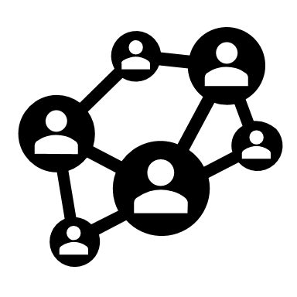
Fundamental research: Guiding principles
Malleable interfaces need guardrails
It is possible to design harmful visualizations, so system designers should anticipate ways to help users personalize safely.
Our ethical responsibility: Accessible defaults first
Some users won't want to personalize or manipulate interfaces at all, so they will still rely on smart, effective defaults.
Persistence, profiles, and "effort-to-usage" ratio
Everything about malleable interfaces should save users time and energy. Let them save, reuse, and share their personalization.
Interoperability: everyone's job
One visualization library isn't enough: the way users personalize a chart in one place should carry over to other platforms and tools.

Slide 52
Prototyping and user testing in Highcharts
Notes:
Frank told you about step 1
Introducing second phase
Integration study on how to make this available to Highcharts users

Slide 53
How to make this available to Highcharts users
Placement of button
Creating proof of concept
Iterative design approach
User testing
Notes:
Placement of button in the chart
Cog wheel
We put the preferences button upper right corner of a chart.
Creating a proof of concept
We took a handful of options to start with, based on Frank’s pre-study.
Iterative design approach
Test, refine and integrate functionality as we go.
First version of proof of concept for user testing is not the same as the last one
User testing
live user testing with user testers from BIT.
ask questions, look at shared screen and shared audio
get real time feedback on how users interact with our proof of concept.

Slide 54
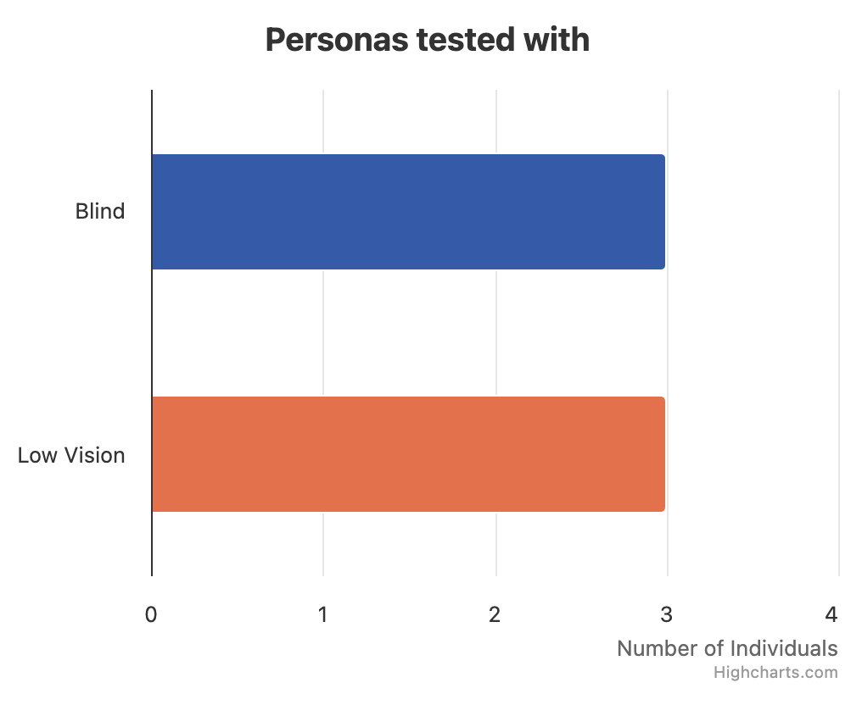
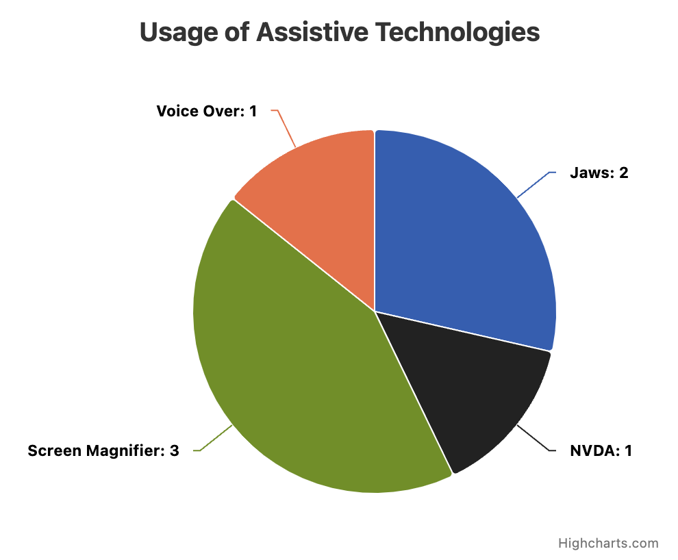
User tester demographics
Notes:
As you can see on the bar chart
3 blind
3 low vision
As you can see on the pie chart of which assistive technology used
1 VoiceOver
2 Jaws
1 NVDA
3 screen magnifier

Slide 55
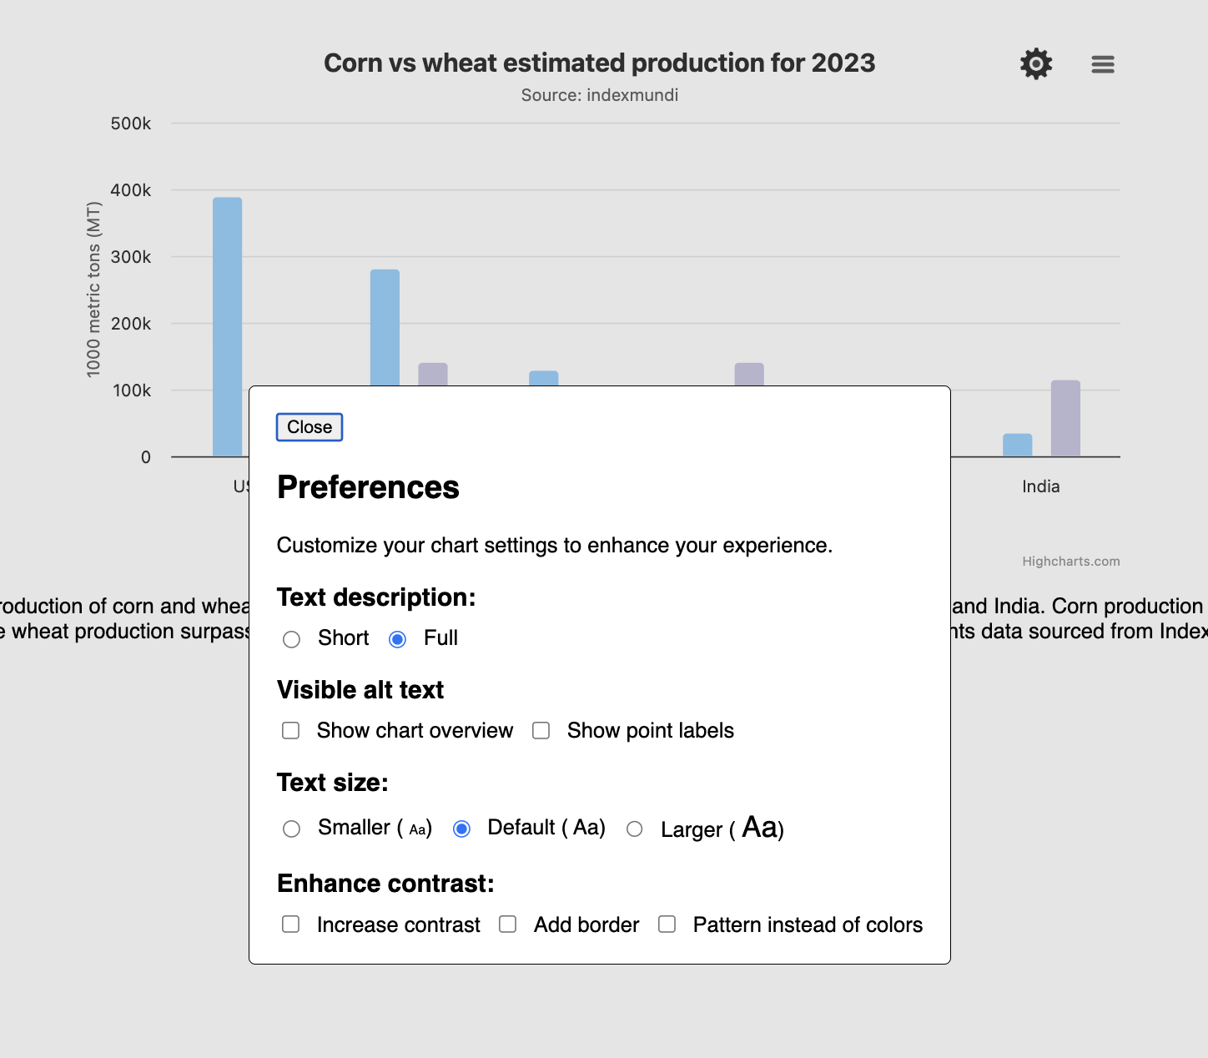
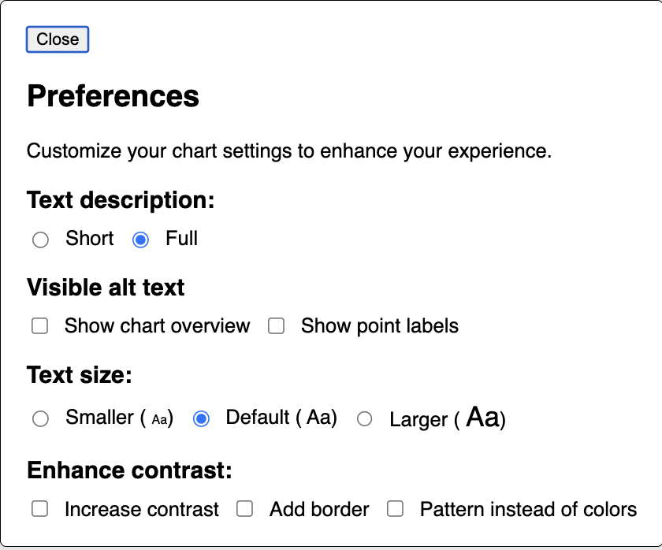
Initial prototype in Highcharts
Notes:
So I’m now showing an image of how the initial prototype looked like with the 4 settings
Short dialog with 4 settings
Text description short/full
Visible alt text
Text size
Enhance contrast
Low contrast on the bars --> Hint to click on the menu for low vision users
Preferences twice --> Hint to click on the menu for screen reader users
Free exploration without context

Slide 56
Current prototype
(Insert video of end result of PoC)
Notes:
Before video:
We'll be happy to demo this at our booth in the exhibit hall
After video:
This leads me into my next slide to talk about global vs local chart settings

Slide 57
Key learnings
Global vs local chart settings
Screen reader users are not clicking the button
Full/short chart summary
Low vision users appreciated visible descriptions
Perfect wording is hard to find
Structure of the menu
Low vision users takes the time to tweak
Notes:
Global vs local chart settings
Most users liked that it was local per chart
Gives flexibility
Default: dark/light, font size
Screen reader users are not clicking the button
They would expect that there is nothing for them in the settings.
Experimented with different accessible names
No one would click it until cued.
Full/short for chart summary
Some users did not seem to detect that there was a noticable change.
Some cued and liked it
Low vision users appreciated visible descriptions
No mouse/keyboard to explore
Making it less of a cognitive load viewing all at once
information overload for some, fine line
Perfect wording is hard to find
The concept of default text size
The concept of system default
Find the best way to create option names to engage users at the right times
Some screen reader users were excited by the “visible alt text”
One low vision user did not want to click “show point description” which was previously called “show point alt text” that because he instantly thought not relevant because he was not using a screen reader
The structure of the menu
Was a dialog that you could close
Labelled with headings for each interactive elements group
Easy to navigate both for sighted and screen reader users
Low vision users takes the time to tweak
They enjoyed setting it up.

Slide 58
"When you end up with something that is just right for me, you enjoy using it more. If it is just 5% better, and you are using it hours a day. That makes a difference."
User tester
Notes:
“When you end up with something that is just right for me, you enjoy using it more.”
“If It is 5% better, and you are using it hours a day, that makes a difference.”

Slide 59
Next steps?
accessibility@highsoft.com
accessibility@elsevier.com
fje@cmu.edu

